Slide 1


Foundations of
Scientific Computing
(SciComp 101)
Dave Biersach
dbiersach@bnl.gov
Session 23 Computational Earth & Space Science

Slide 2
Session 23 – Goals
Implement methods for interpolating multi-dimensional data taken from randomly distributed locations
Analyze the mathematics of the Inverse Distance Weighting (IDW) method to convert non-uniformly measured spatial data to a regular conforming mesh
Use the Root Mean Square Deviation (RMSD) statistic as a measure of model accuracy

Slide 3
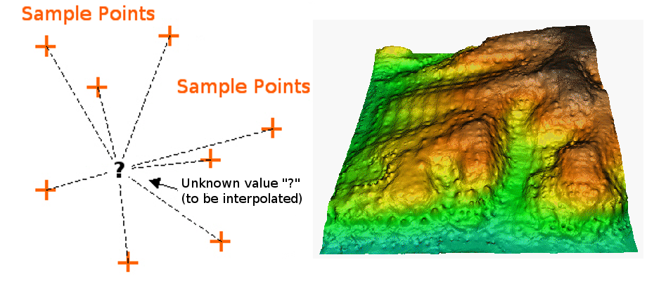
Interpolating Spatial Data

Slide 4
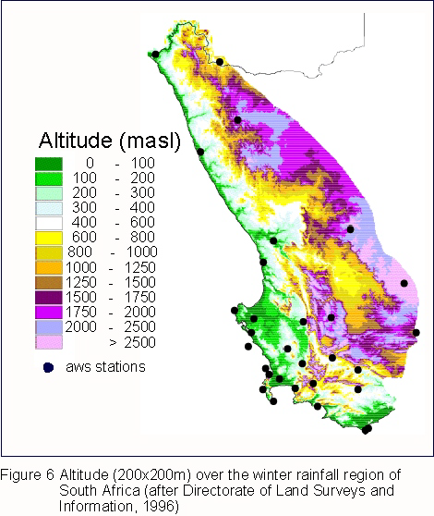
Interpolating Spatial Data

Slide 5
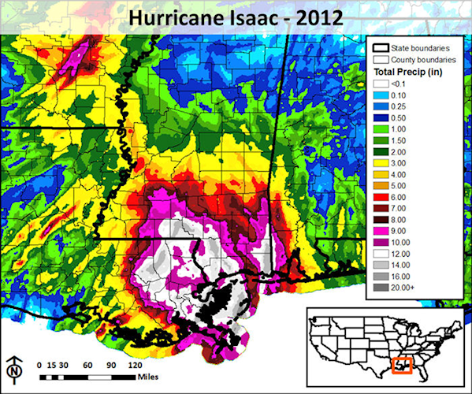
Interpolating Spatial Data

Slide 6
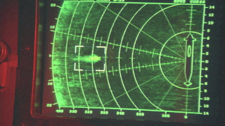
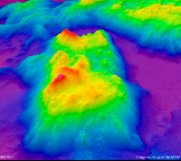


Interpolating Spatial Data
Jonsey Reports

Slide 7
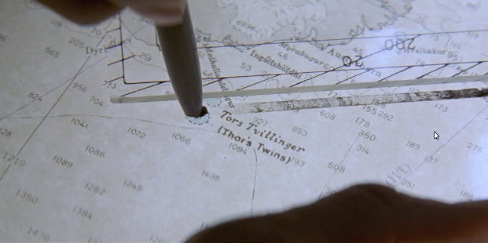
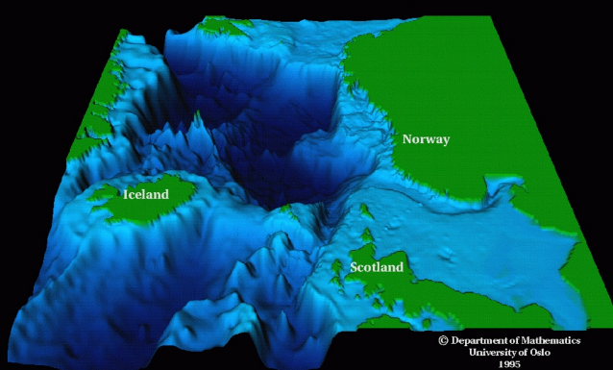
Interpolating Spatial Data
Modi (Brave) and Magni (Strong)

Slide 8
The Inverse Distance Weighting (IDW) Method
IDW is a type of deterministic method for multivariate interpolation of a set of scattered points
The value assigned to unknown points are calculated from a weighted average of the values at the known points
The theory is the farther away a known point is from the unknown point, the less that known distant point can contribute to the unknown height
Closer known points contribute more to the unknown height than known points that are farther away
Your contribution is inverse to your distance

Slide 9
The Inverse Distance Weighting (IDW) Method
75
X
25
5
10
2
10
2
1
3
$\left(\frac{17.5}{0.8}\right)$→

Slide 10
The Inverse Distance Weighting (IDW) Method
75
X
25
5
10
2
10
2
1
3
$\left(\frac{17.5}{0.8}\right)$→

Slide 11
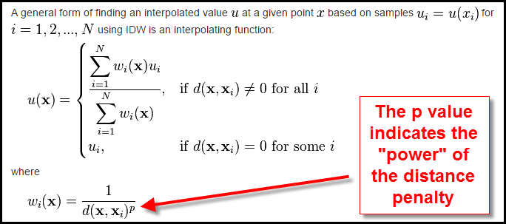
The Inverse Distance Weighting (IDW) Method

Slide 12
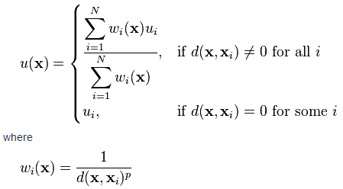
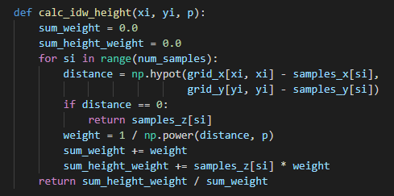
SciComp As Translational Science
"The algorithm that almost won the cold war"
11 lines of code can change the world!
SciComp is the ability to translate mathematical expressions of scientific concepts into correct and efficient software code

Slide 13
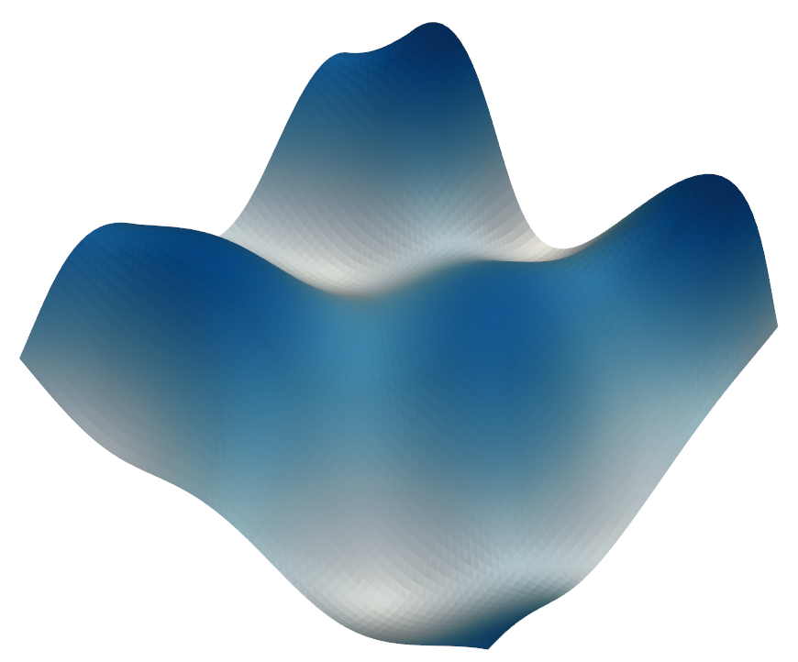
An “Actual” Ocean Floor
$$z=30\sin\left(\frac{y}{40}\right)\cos\left(\frac{x}{40}\right)+50\cos\left(\frac{\sqrt{x^{2}+y^{2}}}{40}\right)−800⁡$$

Slide 14
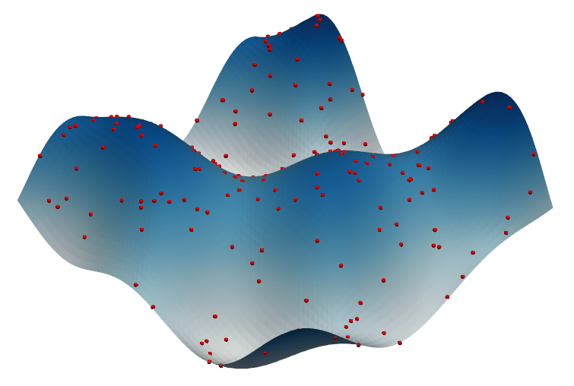
Sample Ocean Depth Soundings
The ocean area is square, 390 units (e.g., nautical mile) per side (152,100 total units)
The area is subdivided into 65 intervals (grid lines) per side (4,225 total intervals, 6 units per interval)
Depth samples (sonar timings) were taken from 220 random locations (e.g., the red dots)

Slide 15
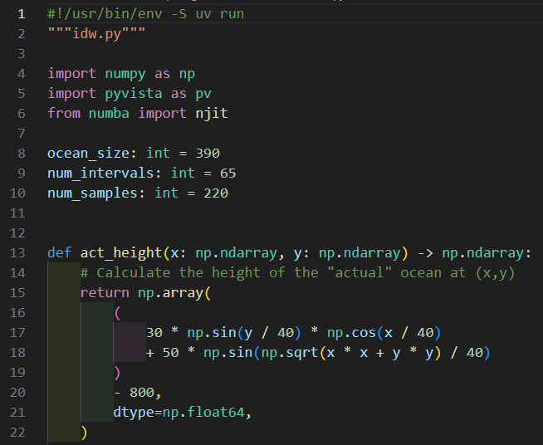
Open idw.py
①
We will talk about the PyVista package in the following two slides…
②
③
These are now global variables…
④
⑤
⑥
$$z=30\sin\left(\frac{y}{40}\right)\cos\left(\frac{x}{40}\right)+50\cos\left(\frac{\sqrt{x^{2}+y^{2}}}{40}\right)−800⁡$$
⑦

Slide 16
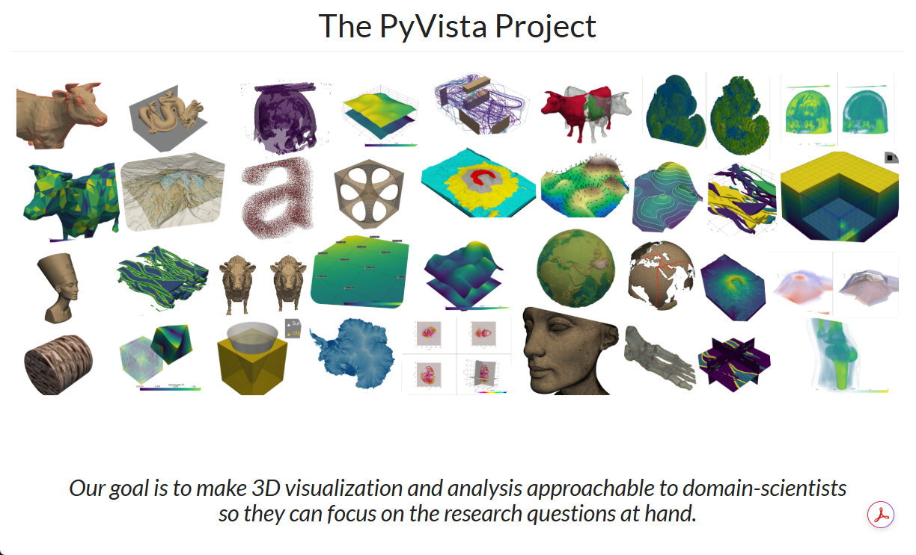
https://pyvista.org

Slide 17
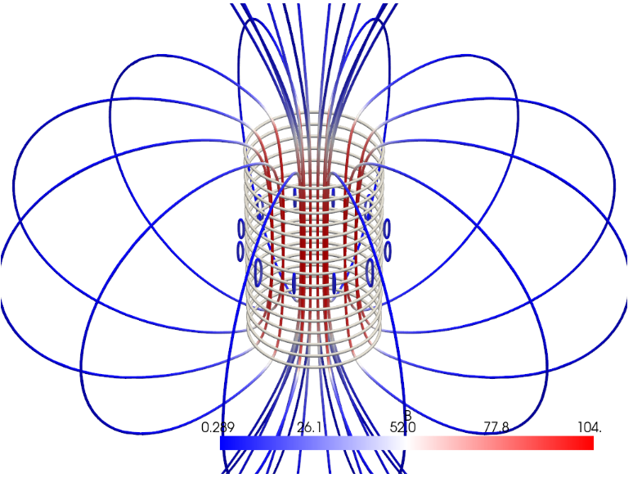
https://pyvista.org

Slide 18
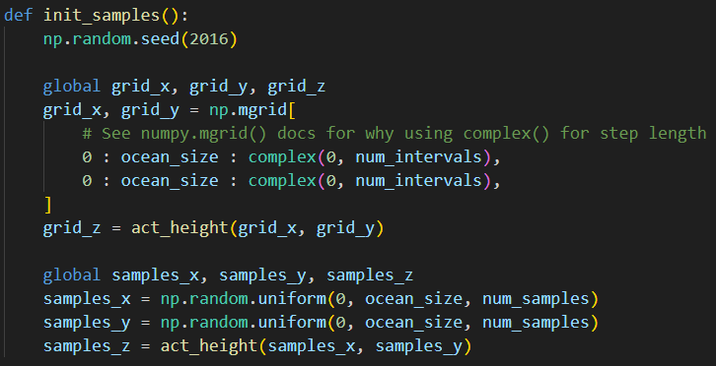
View idw.py
①
②
③
These are now global variables…
④
⑤
The expression start:stop:step is a formal Python slice object. The np.mgrid constructor expects slices as parameter values, but if passed a complex step value, it acts just like np.linspace()

Slide 19
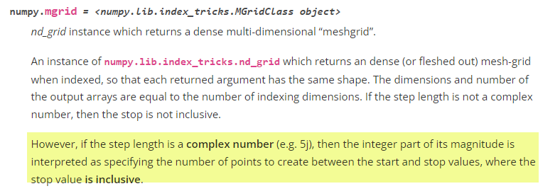
View idw.py
①
②
③
These are now global variables…
④
⑤
THIS IS AN UGLY HACK!
The expression start:stop:step is a formal Python slice object. The np.mgrid constructor expects slices as parameter values, but if passed a complex step value, it acts just like np.linspace()

Slide 20
View idw.py
①
②
③
④
⑤
⑥
In the real world, we would not know this!
⑦
⑧
⑨
The expression start:stop:step is a formal Python slice object. The np.mgrid constructor expects slices as parameter values, but if passed a complex step value, it acts just like np.linspace()

Slide 21
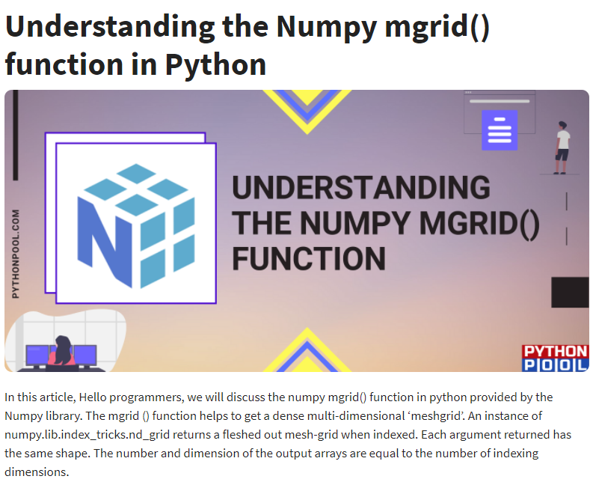
https://www.pythonpool.com/numpy-mgrid

Slide 22
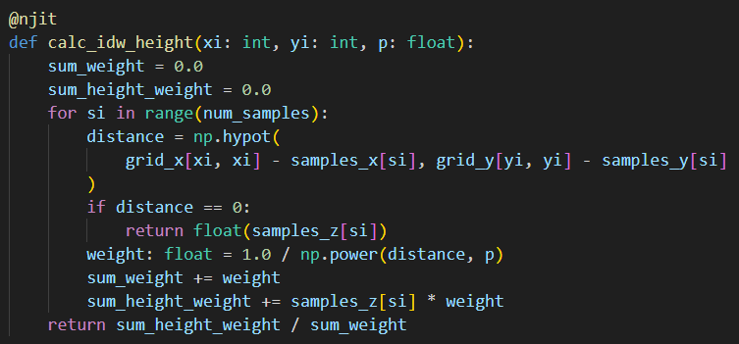
View idw.py
①
②
③
④
⑤
Pythagorean Distance Formula
⑥
If we are at a sampled point, use the measured depth
⑦
p is a tunable power parameter
⑧
When using Numba, it is often necessary to formally declare the type of each variable if it cannot be inferred (e.g., 0.0 for float)

Slide 23
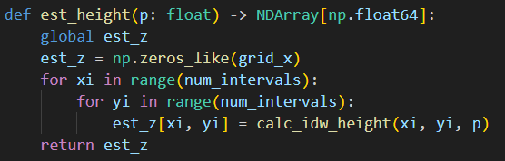
View idw.py
①
②
③
④
⑤
⑥
⑦
est_z is a NumPy array of type np.float64
However, its shape is that of a 2D matrix,
not a 1D vector

Slide 24
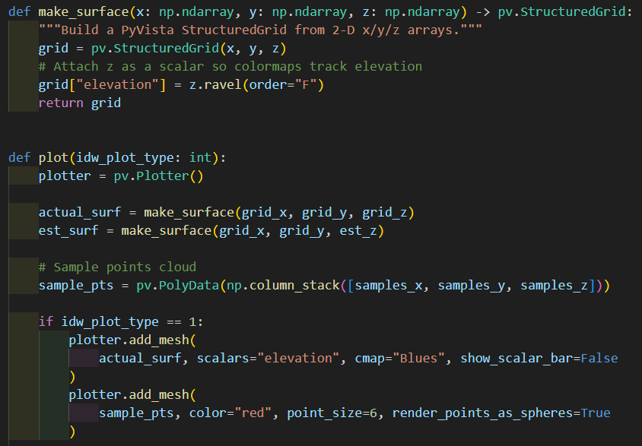
View idw.py
④
⑤
Flattens the 2D z-array using Fortran (column-major) order
⑥
①
②
③
⑦
A bag of disconnected points with no implied connectivity
⑧
Actual Sea Floor
⑨
⑩

Slide 25
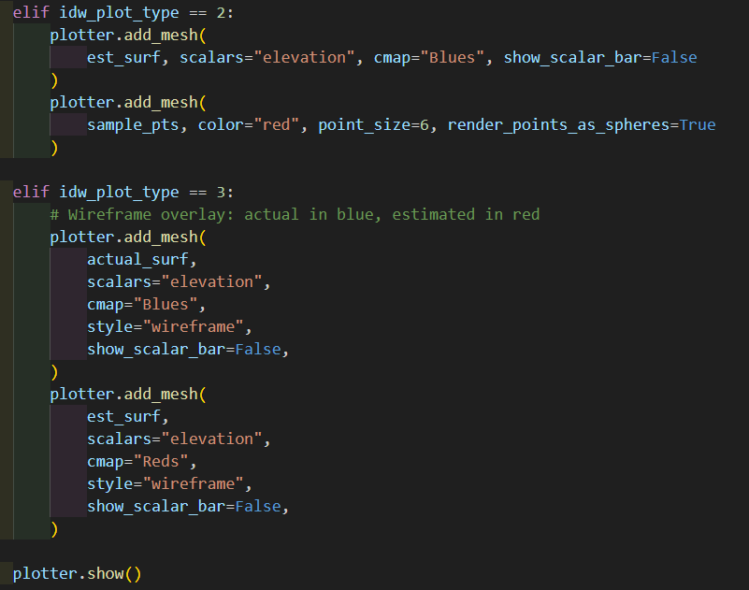
View idw.py
①
②
③
④
⑤
⑥
⑦
⑧
⑨
⑩

Slide 26
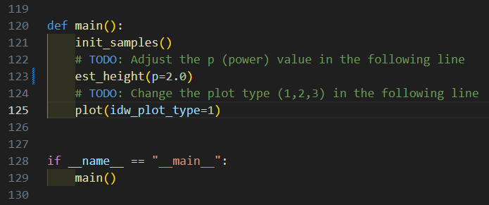
View idw.py
③
④
⑤
⑥
①
②

Slide 27
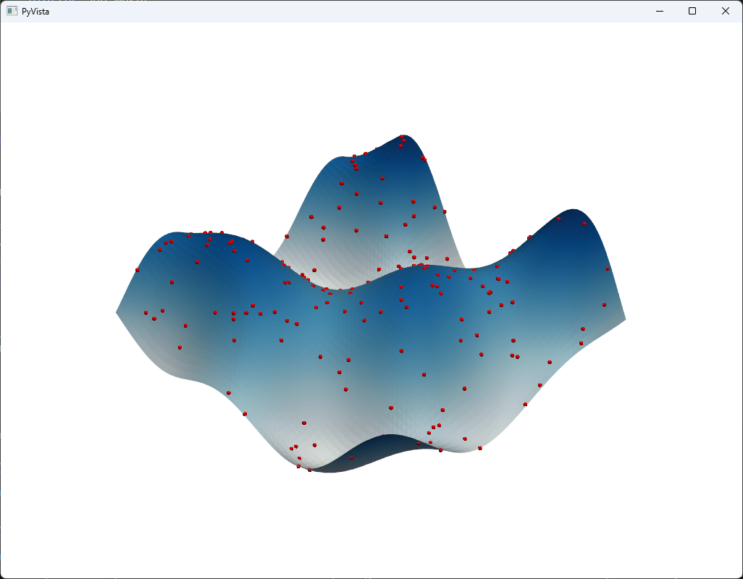
Run idw.py
Left Click & Drag
to Rotate
(Yaw & Pitch)

Slide 28
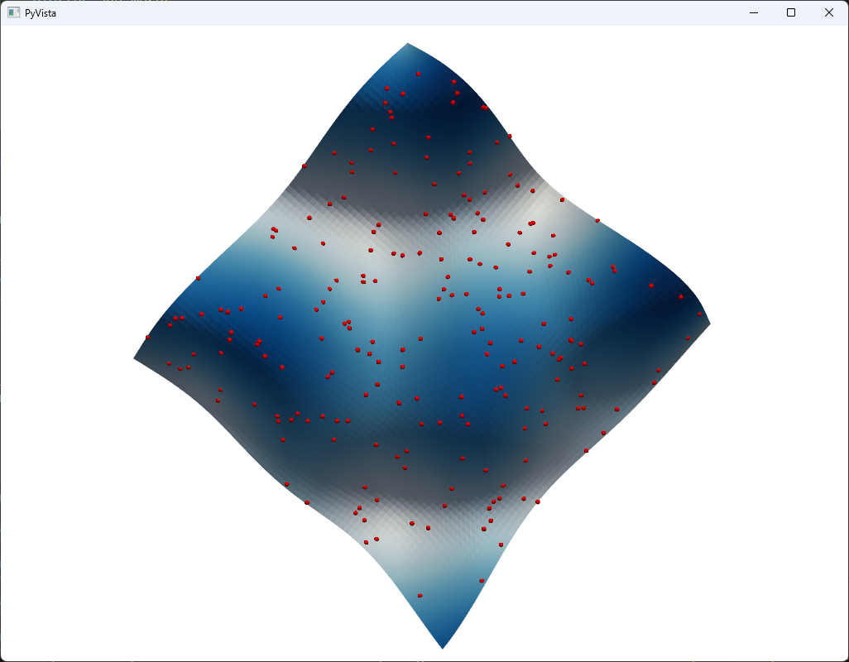
Run idw.py
CTRL (CMD) + Left Click & Drag to Roll

Slide 29
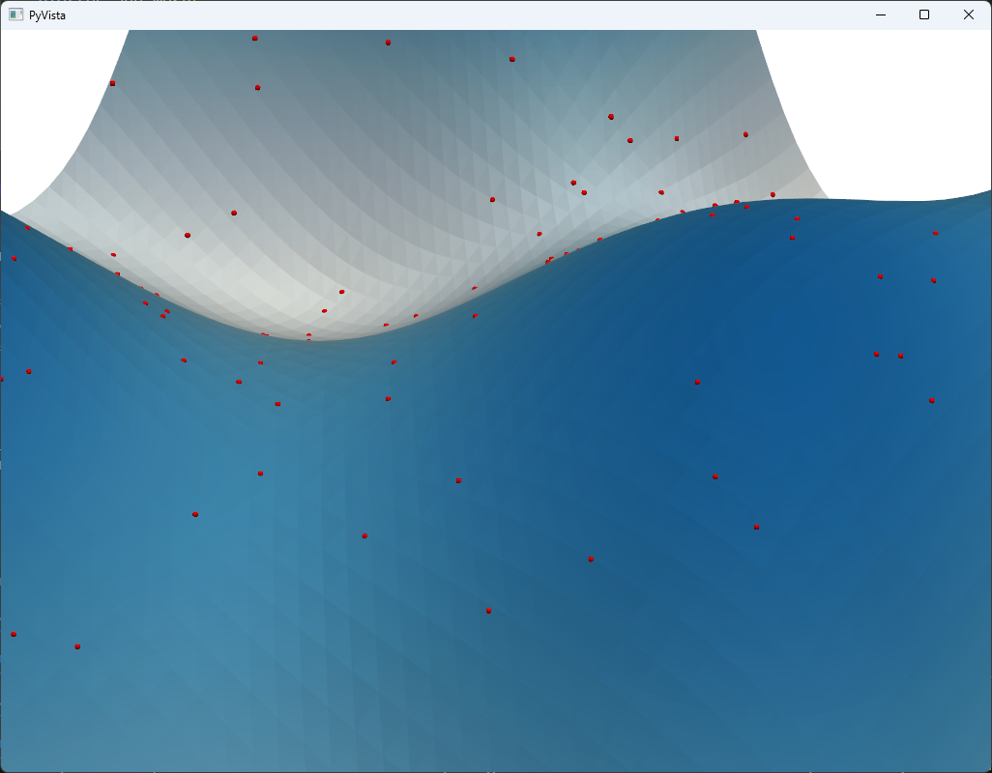
Run idw.py
Right Click & Drag to Zoom

Slide 30
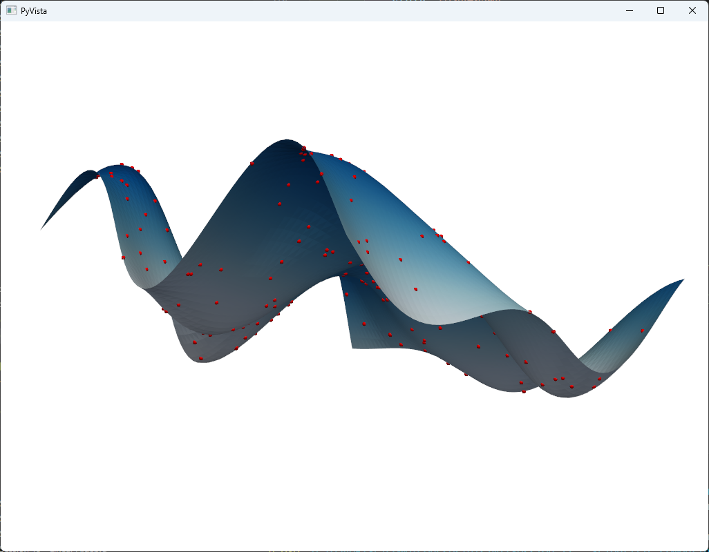
Run idw.py
Close window to return to VSCode

Slide 31
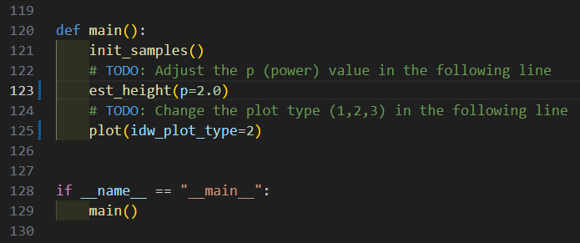
Edit idw.py
Estimated Sea Floor
Set plot type to 2

Slide 32
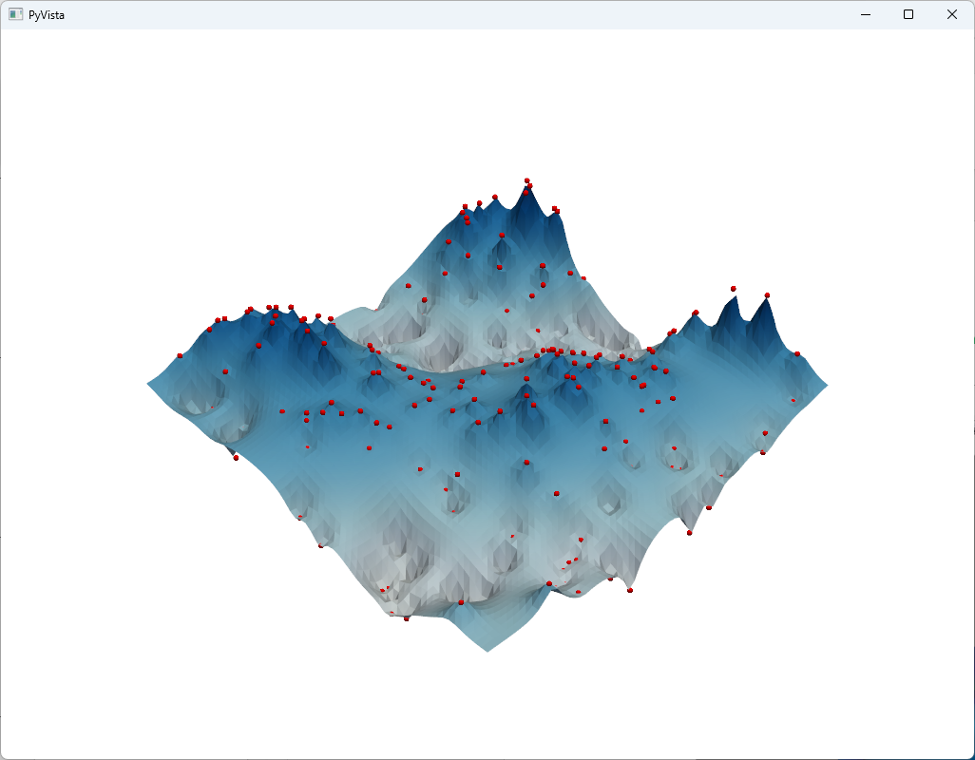
Run idw.py
$$p=2.0$$

Slide 33
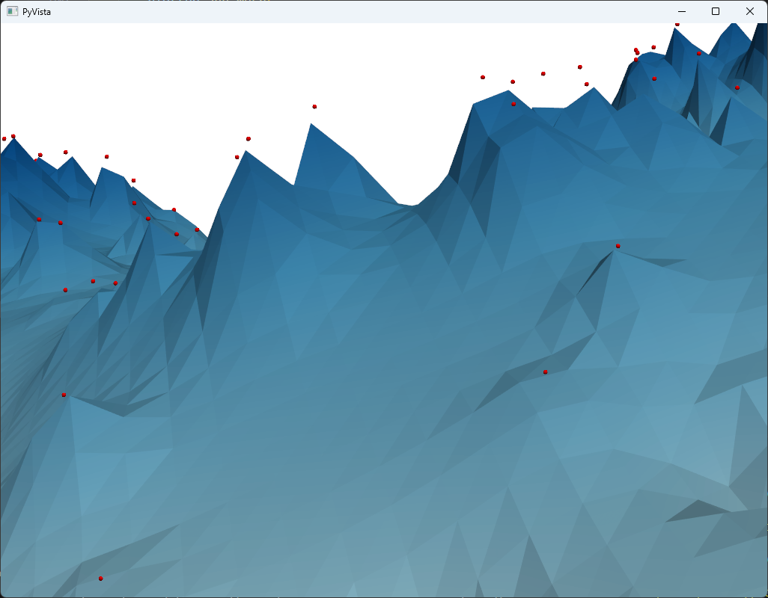
Run idw.py
The surface does not meet many of the samples

Slide 34

Edit idw.py
Set $p=5.0$

Slide 35
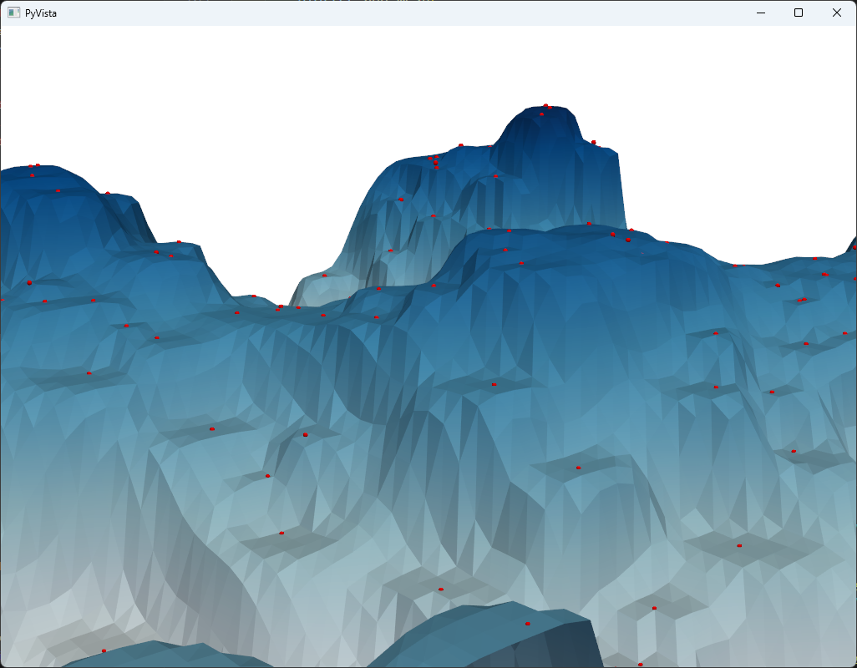
Run idw.py
$$p=5.0$$
The surface seems to touch more samples

Slide 36
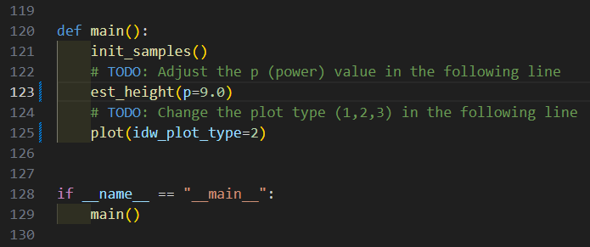
Edit idw.py
Set $p=9.0$

Slide 37
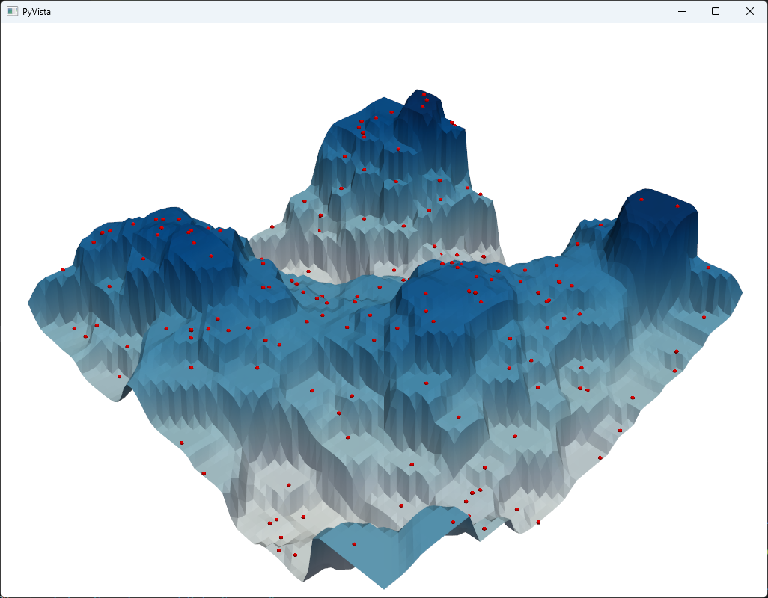
Run idw.py
$$p=9.0$$
The surface seems artificial (overfitted)

Slide 38

Edit idw.py
Wireframe Mesh
Set plot type to 3

Slide 39
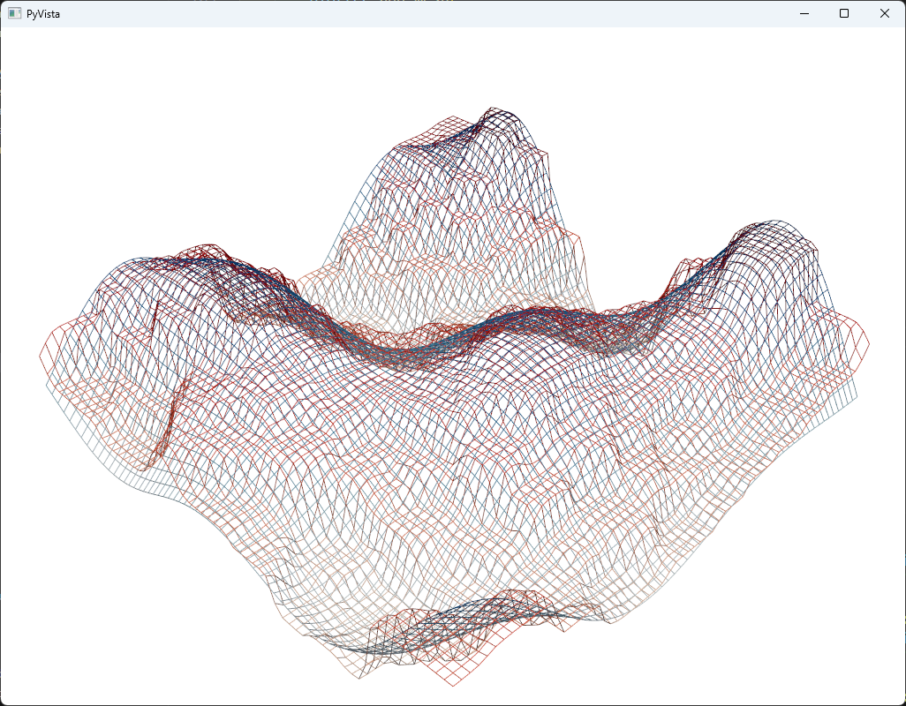
Run idw.py
Blue = Actual
Red = Estimated

Slide 40
Root Mean Square Deviation
As we increase the power term p, is our model getting better or worse at predicting reality?
The root-mean-square deviation (RMSD) is a statistic to measure the difference between the values predicted by a model versus the observed values
By averaging the errors ${(actual−estimated)}^{2}$ across all sample points, we calculate a comparative statistic that can help empirically determine the optimal p value because it will minimize the overall error of the model
$$RMSD=\sqrt{\frac{\sum_{t=1}^{n}{{\left(\hat{y_{t}}−y\right)}^{2}}}{n}}$$

Slide 41
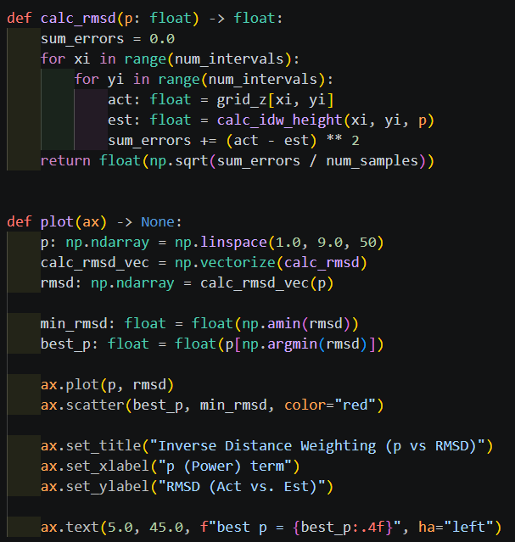
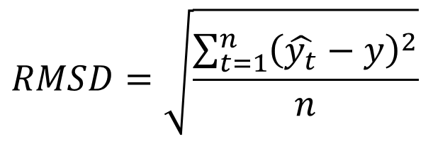
Open idw_min_rmsd.py
④
⑤
⑥
⑦
⑧
⑨
①
②
③

Slide 42
View idw_min_rmsd.py
①
②
③
④
⑤

Slide 43
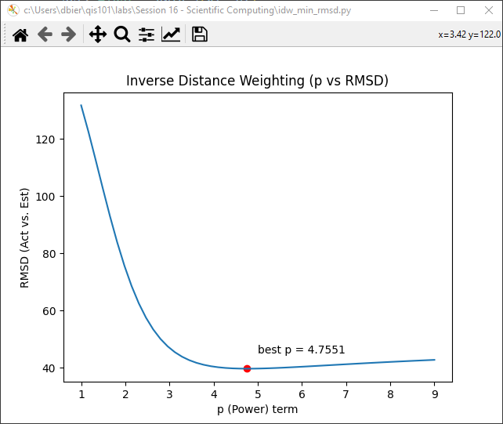

Run idw_min_rmsd.py
The best $p$ varies for each patch across the entire ocean
For this patch of the ocean…

Slide 44
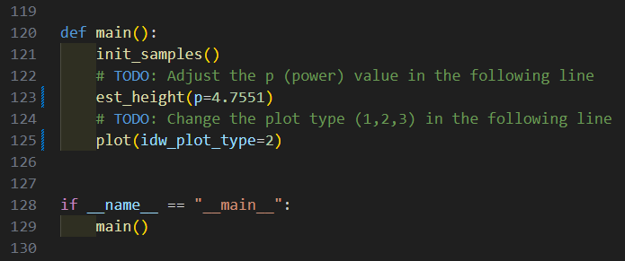
Edit idw.py
Set power to 4.7551
Set plot type to 2

Slide 45
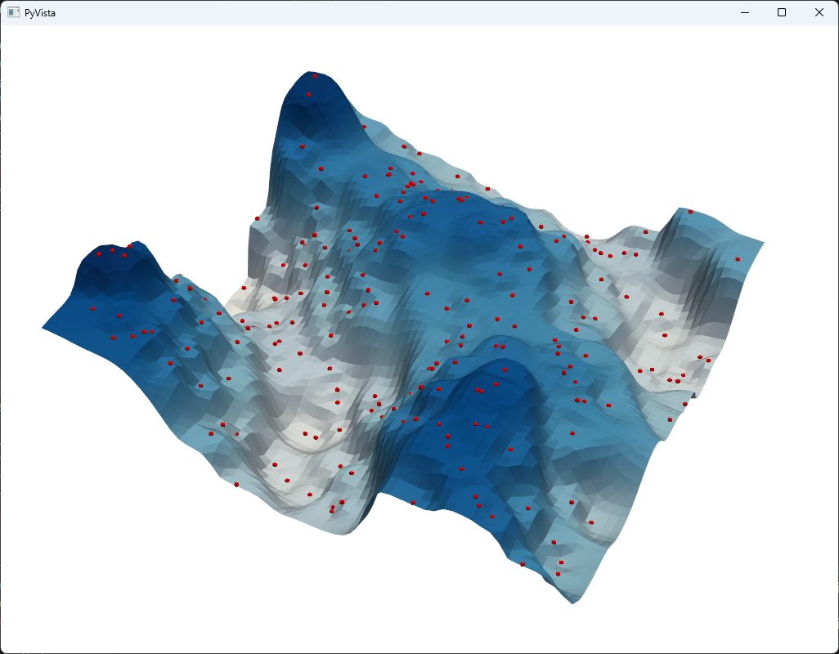
Run idw.py
$$p=4.7551$$
The mesh having least error with the known samples

Slide 46
Session 23 – Now You Know…
The Inverse Distance Weighting (IDW) method can interpolate multi-dimensional data taken from random sample locations
How to convert non-uniformly measured spatial data into a regular conforming mesh
How to use RMSD as one metric to characterize the “goodness of fit” for predicted interpolated data points
Scientists rarely enjoy the luxury of having too many data samples and must often interpolate to fill in the missing gaps in their observations

